Slide 1


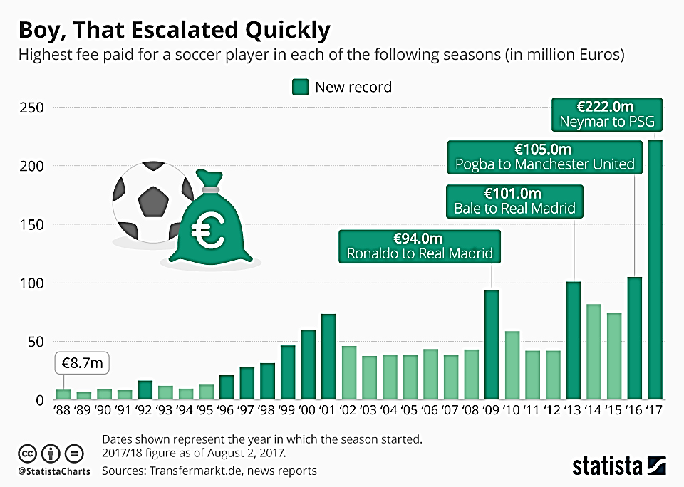
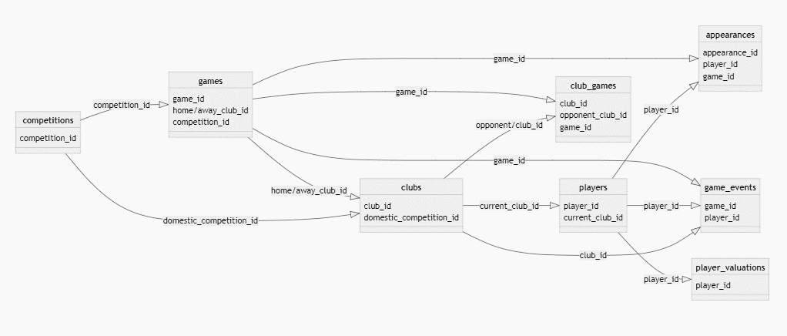
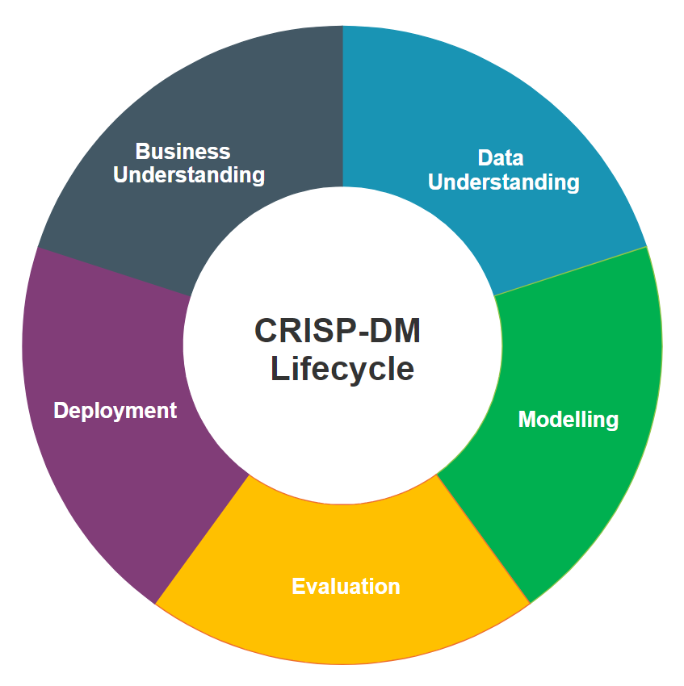
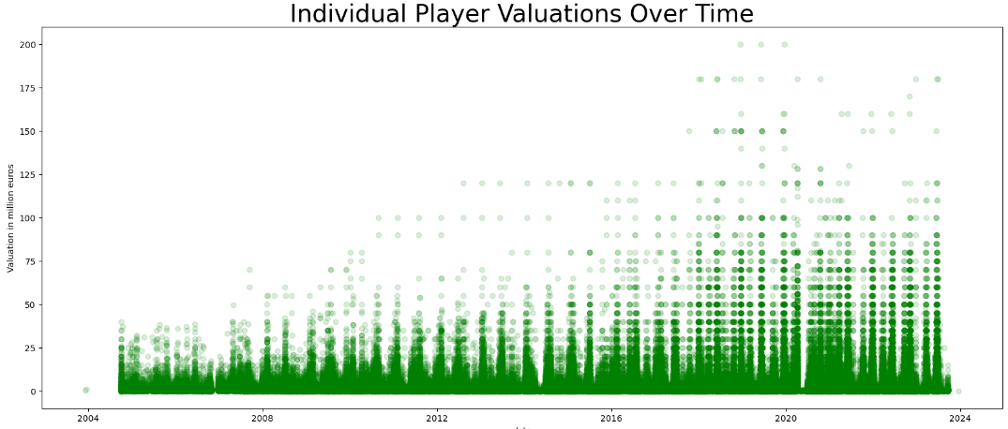
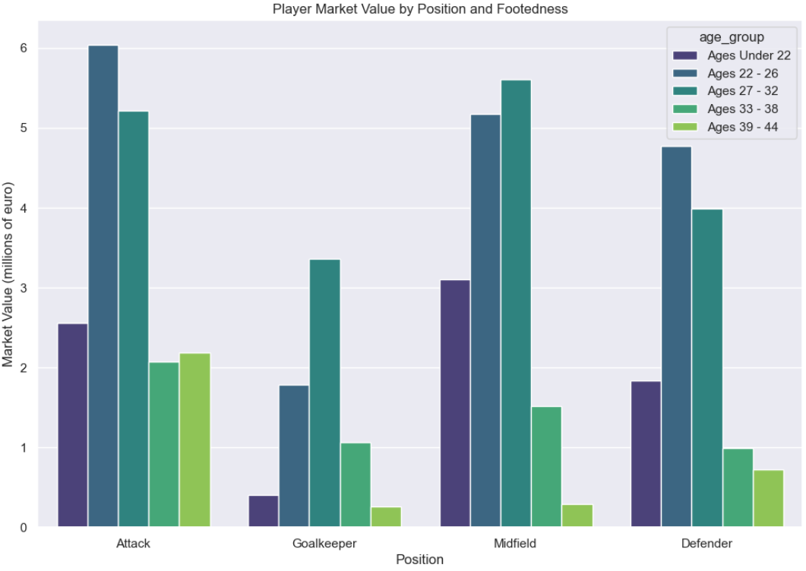

Leveraging Machine Learning and Data Science for Competitive Advantage: Estimating Player Market Values
By Kavi Patak
Introduction
The role of analytics in football has evolved over the past decade, and will continue to do so. Technological developments continue to improve the volume and quality of data available to the world’s leading clubs, as well as the ability to derive insight from them. The opportunity exists for clubs of all sizes to use analytics to build a sustainable competitive advantage, something which will be most evident in the area where they invest most: the transfer market.
The Process…
Business Understanding
The role of analytics in football has evolved over the past decade, and will continue to do so. Technological developments continue to improve the volume and quality of data available to the world’s leading clubs, as well as the ability to derive insight from them. The opportunity exists for clubs of all sizes to use analytics to build a sustainable competitive advantage, something which will be most evident in the area where they invest most: the transfer market.
Data Understanding
The role of analytics in football has evolved over the past decade, and will continue to do so. Technological developments continue to improve the volume and quality of data available to the world’s leading clubs, as well as the ability to derive insight from them. The opportunity exists for clubs of all sizes to use analytics to build a sustainable competitive advantage, something which will be most evident in the area where they invest most: the transfer market.
The role of analytics in football has evolved over the past decade, and will continue to do so. Technological developments continue to improve the volume and quality of data available to the world’s leading clubs, as well as the ability to derive insight from them. The opportunity exists for clubs of all sizes to use analytics to build a sustainable competitive advantage, something which will be most evident in the area where they invest most: the transfer market.

Slide 2
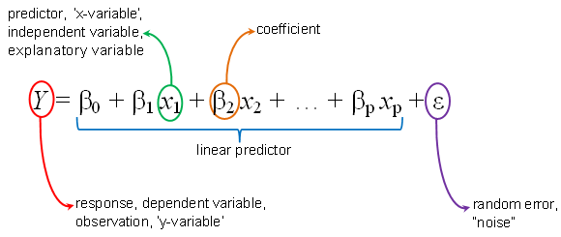
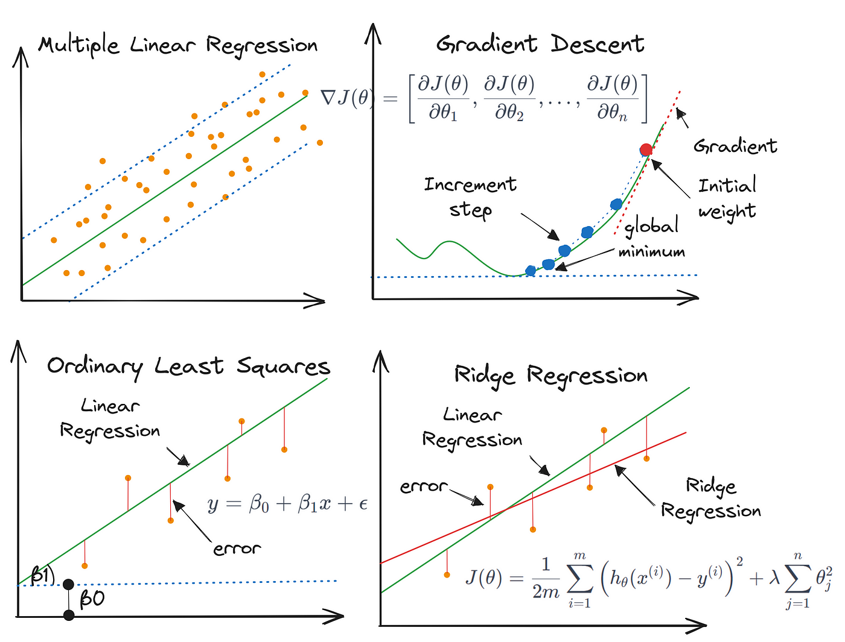
Leveraging Machine Learning and Data Science for Competitive Advantage: Estimating Football Player Market Values
Author: Kavi Patak Lecturer: James Garza
Introduction
The role of analytics in football has evolved over the past decade, and will continue to do so. Technological developments continue to improve the volume and quality of data available to the world’s leading clubs, as well as the ability to derive insight from them. The opportunity exists for clubs of all sizes to use analytics to build a sustainable competitive advantage, something which will be most evident in the area where they invest most: the transfer market.
The Process…
Business Understanding
Evaluation
The role of analytics in football has evolved over the past decade, and will continue to do so. Technological developments continue to improve the volume and quality of data available to the world’s leading clubs, as well as the ability to derive insight from them. The opportunity exists for clubs of all sizes to use analytics to build a sustainable competitive advantage, something which will be most evident in the area where they invest most: the transfer market.
Modelling
Data Understanding
The role of analytics in football has evolved over the past decade, and will continue to do so. Technological developments continue to improve the volume and quality of data available to the world’s leading clubs, as well as the ability to derive insight from them. The opportunity exists for clubs of all sizes to use analytics to build a sustainable competitive advantage, something which will be most evident in the area where they invest most: the transfer market.
The role of analytics in football has evolved over the past decade, and will continue to do so. Technological developments continue to improve the volume and quality of data available to the world’s leading clubs, as well as the ability to derive insight from them. The opportunity exists for clubs of all sizes to use analytics to build a sustainable competitive advantage, something which will be most evident in the area where they invest most: the transfer market.
Deployment
References

Slide 3
